Slide 1
Update on Balancing Platforms
8th October 2026
MESC meeting

Slide 2
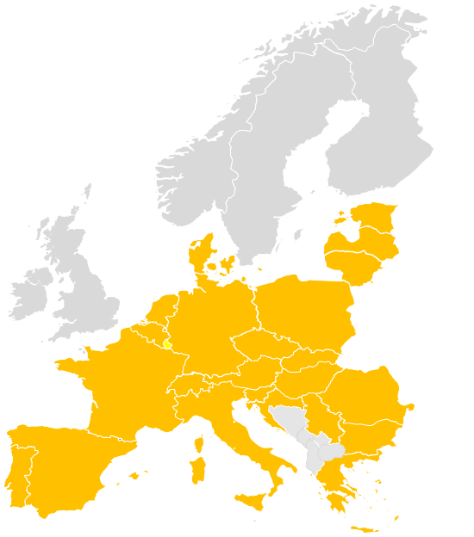
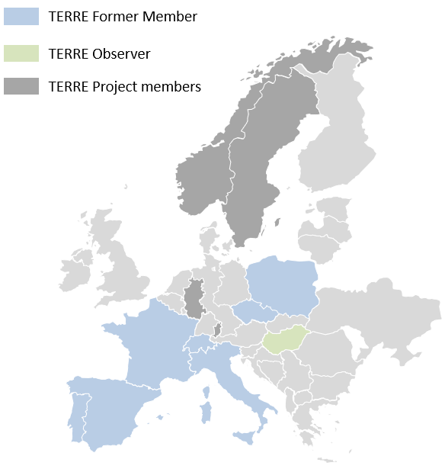
Introduction
Overview status of European Balancing Platforms
Project / Balancing service | IGCC IN | PICASSO aFRR | MARI mFRR | TERRE RR
Participants
Economic surplus 2025 | 301 m€ | 464 m€ | 104 m€ | 316 m€
m€/a
  2025: All platforms together achieved an economic surplus of ~1.185 bn€ with total project cost* of ~42 m€
*Common and national CAPEX and OPEX Cost 2025

Slide 3
Recent developments and updates
Go-lives at PICASSO
2026 accession recap:
  July: ELES
  October: MAVIR
2027 accessions expectation:
  Q2: Transelectrica, HOPS
  Q4: REN, SVK
2028 accessions expectation:
  Q1: Statnett
Link to the latest Accession Roadmap published
  An updated Accession Roadmap is foreseen to be published in the 2nd half of October 2026.
In operation
Plan to join
Technical readiness*
* The technical readiness of Swissgrid has been acknowledged. The participation of Switzerland in the aFRR-Platform is regulated based on article 1.6 and 1.7 of the EB Regulation and is currently the subject of litigation by Swissgrid at the Court of Justice of the European Union
https://www.entsoe.eu/network_codes/eb/picasso/

Slide 4
Recent developments and updates
Go-lives at MARI
2026 accession recap:
  17 February: ESO (link to communication note)
  15 April: RTE (link to communication note)
  15 July: ELES (link to communication note)
  5 October: MAVIR (link to communication note)
2026 accessions expectation:
  Nov: Terna
  Dec: PSE
2027 accessions expectation:
  Q2: HOPS, Transelectrica
  Sep-Oct?: Energinet, Fingrid, Statnett & Svk
2028 accessions expectation:
  Q3: IPTO
Link to the latest Accession Roadmap published
  Since the publication accession plans of Terna and Transelectrica changed. The latest plans can be found in the overview above.
  An updated Accession Roadmap is foreseen to be published in the 2nd half of October 2026.
In operation
Technical readiness to participate operationally*
Plan to join
Technical readiness**
MARI observer
* As of 18 Feb 2026, ESO is operating in island mode. While no bids or demands are submitted to MARI, ESO has the technical readiness to participate operationally.
**The technical readiness of Swissgrid has been acknowledged. The participation of Switzerland in the aFRR-Platform is regulated based on article 1.6 and 1.7 of the EB Regulation and is currently the subject of litigation by Swissgrid at the Court of Justice of the European Union
https://www.entsoe.eu/network_codes/eb/mari/

Slide 5




Balancing Stakeholders Workshop
All TSOs via ENTSO-E aim to keep stakeholders informed of the evolution of the European platforms while gathering their feedback for future developments.
The balancing projects in collaboration with ENTSO-E are invite you to a hybrid organised public online workshop.
The event will be held both online via MS Teams and physically at the ENTSO-E premises in Brussels on 28 October 2026 from 10:00 AM - 12:00 PM.
Please register to the workshop here.

Slide 6
Thank you!
Confidentiality Notice
The information presented in this meeting is confidential and must not be shared with external parties, including via social media.

